Slide 1

Unit 2
Let‘s talk teens

Slide 2

Let’s talk teens
I don’t know what “home” is, but unhappiness and worries melt away once there.
－Bing Xin

Slide 3

What does “home” mean to you?
a warm bed
a nice meal
a helping hand
a place to grow

Slide 4
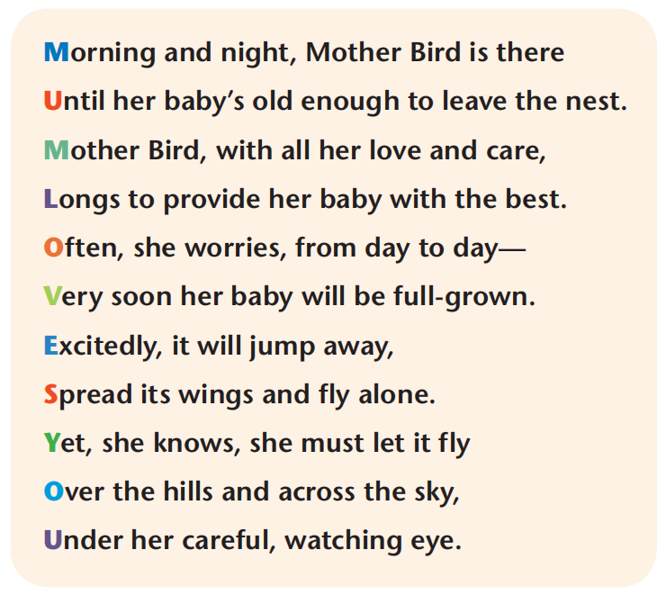
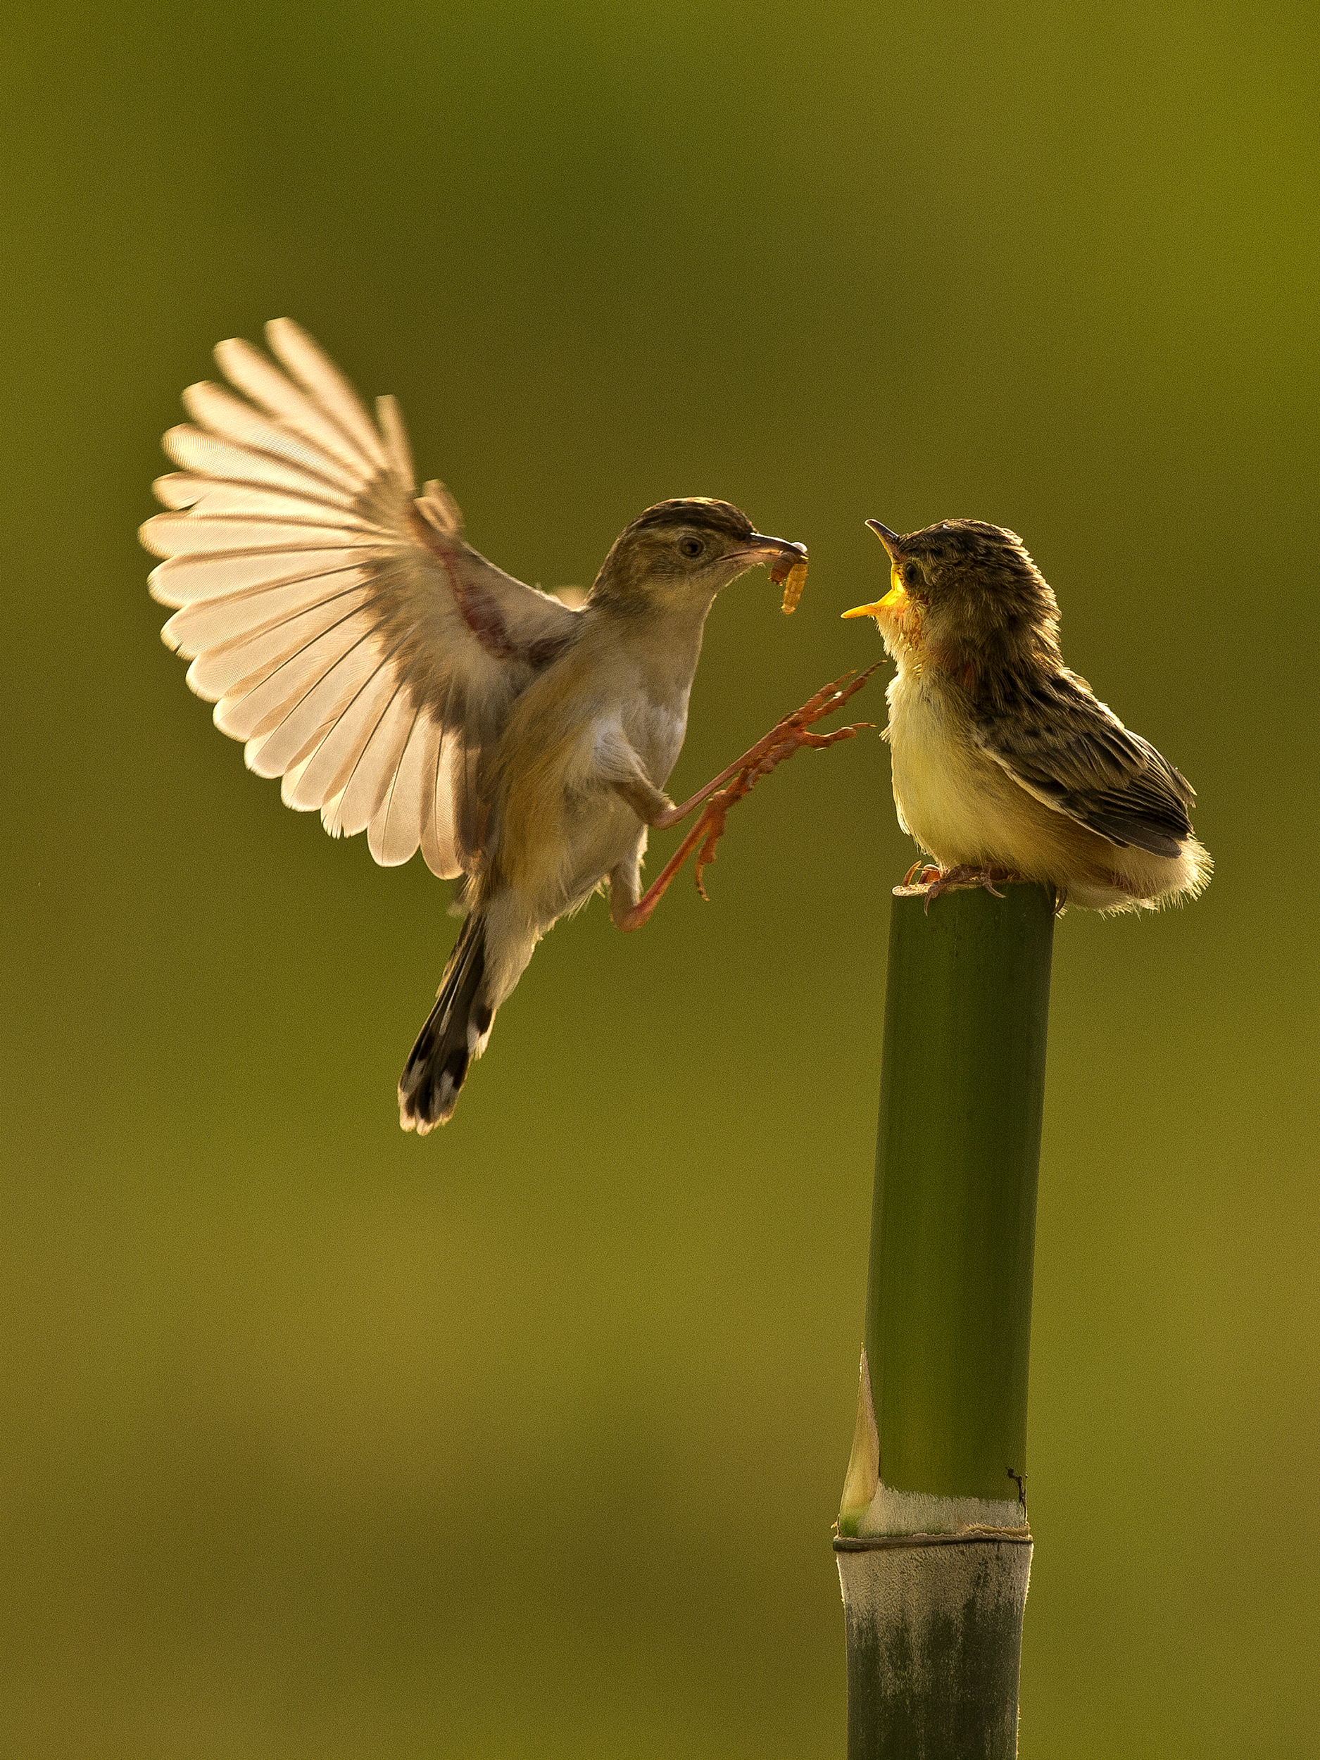

Welcome to the unit
Read the poem loudly!

Slide 5
Welcome to the unit
在雏鸟羽翼初丰，离巢独飞之前，
母亲一直守着它，不分昼夜。
母亲，倾注所有的爱与关怀，
渴望给自己的宝贝最好的庇护。
日复一日，心中常有忧愁袭来——
很快她的宝贝就会长成。
它会满怀兴奋，一跃而起，
伸展双翅，孤身分离。
然而，她深知，必须放手，
任它飞跃高山，翱翔长空，
在她关切的凝视中。

Slide 6
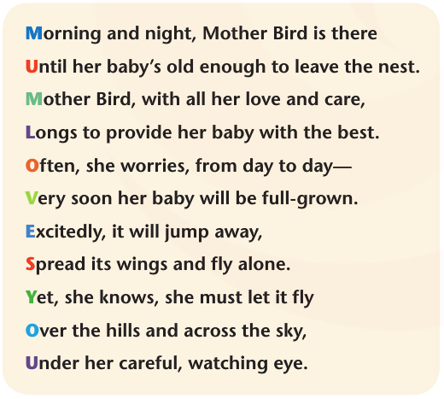



How many parts can you divide the poem into?
(1-4)
(5-8)
(9-11)

Slide 7
What is the main idea of each part?
Part 2 describes Mother Bird’s worry about her baby when it grows up and tries to leave her.
Part 1 is about how the mother bird brings her baby up when it is young.
Part 3 shows the mother bird will let her baby live independently despite her concern and reluctance（不愿） to let it go.
How would you describe Mother Bird’s feelings in the poem.

Slide 8
Mother Bird’s feeling
Mother bird has mixed feelings about her baby. On the one hand, she is very protective of her baby. On the other hand, she understands that when her baby has grown up she will have to give it more freedom. However, she will always be there for her baby.

Slide 9
Try to feel the rhythm and rhyme of the poem.
Rhythm(韵律) means a strong regular repeated pattern of sounds .
Rhyme（韵脚） is a word which has the same sound or ends with the same sound as another word.
Can you find any rhymes in this poem?

Slide 10
Morning and night，Mother Bird is there
Until her baby’s old enough to leave the nest.
Mother Bird, with all her love and care,
Longs to provide her baby with the best.
Often, she worries, from day to day-
Very soon her baby will be full-grown.
Excitedly, it will jump away,
Spread its wings and fly alone.
Yet, she knows, she must let it fly
Over the hills and across the sky,
Under her careful, watching eye.
MUM LOVES YOU

Slide 11
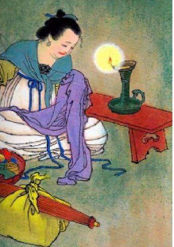
What Chinese poems about parents' love for their children can you think of?
《游子吟》
唐·孟郊
慈母手中线，游子身上衣。
临行密密缝，意恐迟迟归。
谁言寸草心，报得三春晖。

Slide 12

Comparison
Song of the Parting Son
A thread in one hand of the loving mother,
A dress of the parting son in the other.
She sews stitch by stitch: his departure's near,
For fear that he won't be home in many a year.
Who can tell, how much should the son impart,
To well reward the loving mother's heart?
What similarities do the two poems have?

Slide 13
Love
Expectations
Patience
Concerns
Independence
Freedom
Eagerness
Gratitude
Are you always happy with your parent’s
unconditional（无条件的） love?

Slide 14
What kind of parents are good in your view?
kind, loving, humorous, strict,
open-minded, fair, understanding,
patient, learned, helpful, forgiving
充满爱心的
幽默的
思想开放的
公平的
善解人意的
博学 的
宽宏大量的

Slide 15


My Career Experience:
The daily life of
an editorial intern

Slide 16
Today is your first day as an intern editor (实习编辑), and while handling emails, you find a letter of assistance (求助信)...
Dear Editor,
I'm Jane, a high school student. Recently, I had an argument with my mom. When cleaning the room, she found the novel I was writing, and thinks I'm not studying hard enough. What’s worse, she now wants to send me to extra classes!
She always makes decisions for me without ever considering my feelings! I feel pressured and upset because I think I should have some personal time too.
I know my mom means well, but I love writing and think it's important. I don't know what to do. Could you please help me and give me some advice?
Yours sincerely,
Jane

Slide 17

After reading this letter, you decide to write a reply to help her ease her relationship (缓和关系) with her mother. However, before that, you need to read some relevant articles (相关文章) to gain a more comprehensive understanding (全面理解) of the parent-child tensions during adolescence.

Slide 18
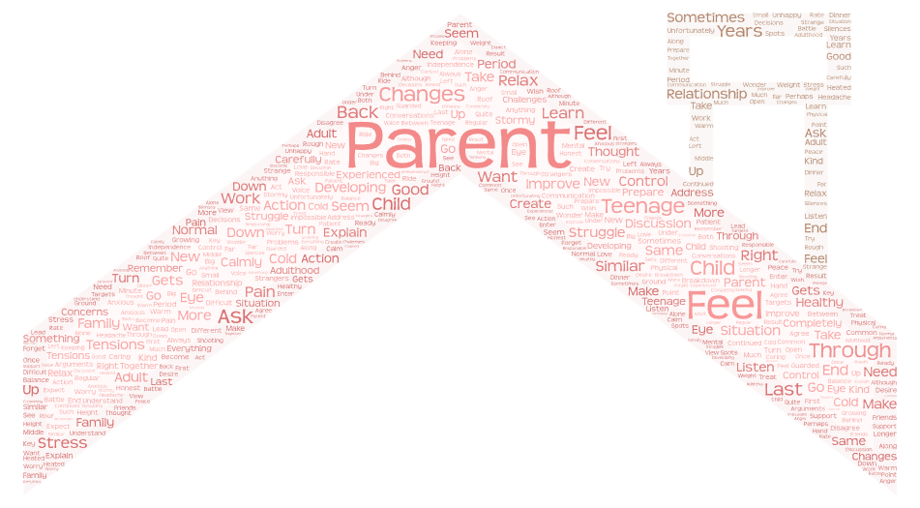
Prediction
Global Reading
Detailed Reading
Thinking
Application
Strangers under the same roof?

Slide 19
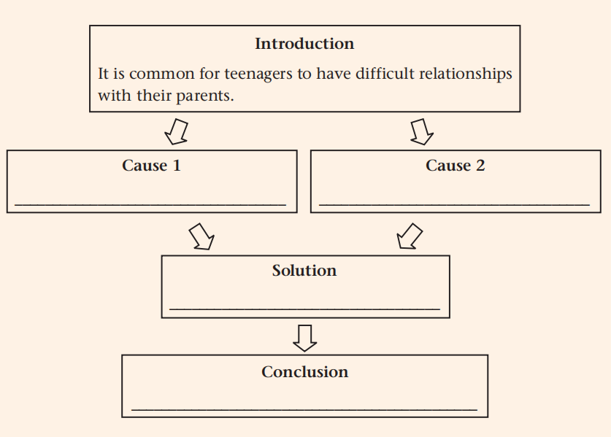
Prediction
Global Reading
Detailed Reading
Thinking
Application
Teenagers' physical changes may result in such family tensions.
Teenagers’ developing mental needs can also influence parent-child relationships.
Teenagers should have regular and honest communication with their parents.
Everything will turn out all right in the end.

Slide 20
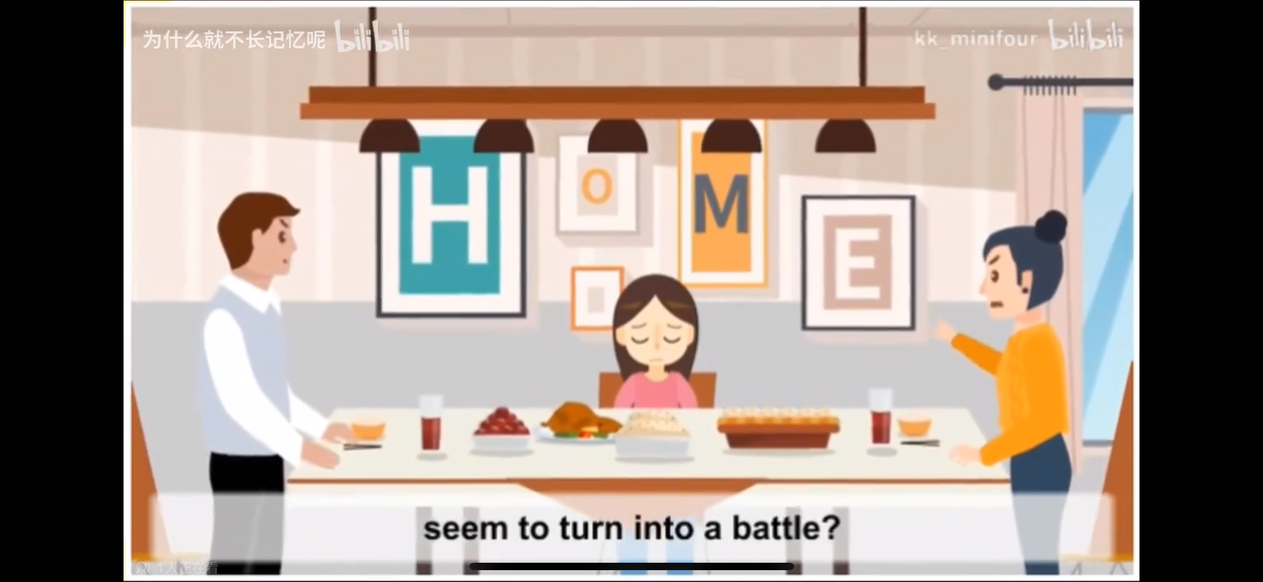
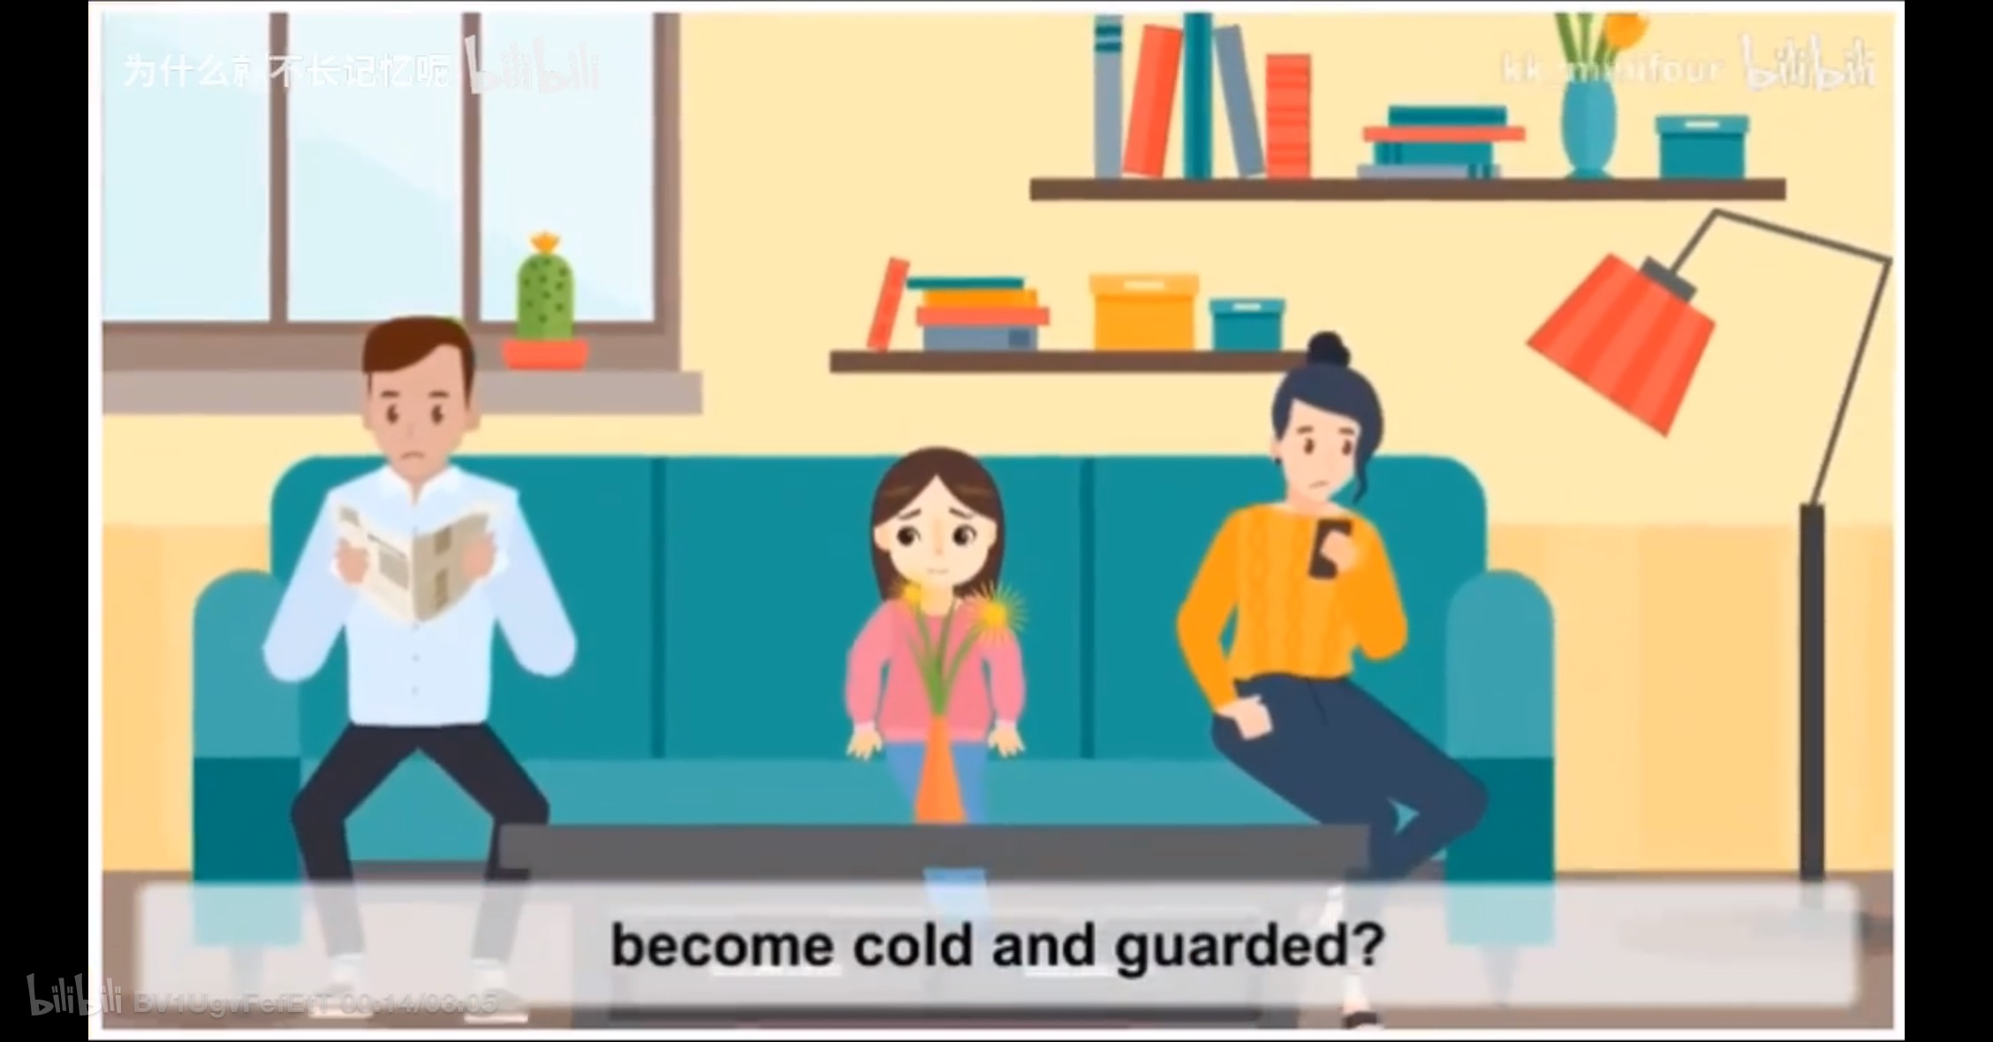
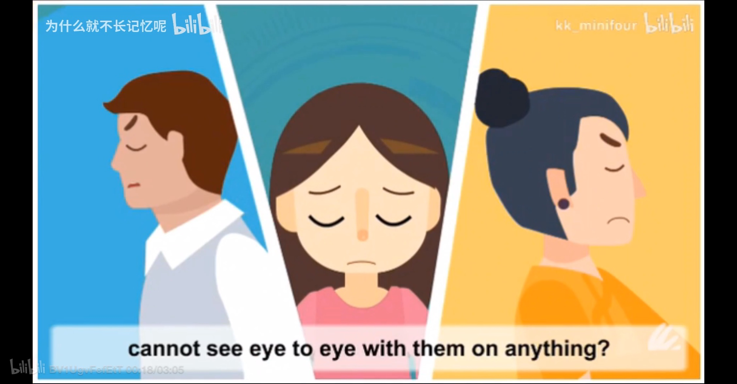
Prediction
Global Reading
Detailed Reading
Thinking
Application
Introduction
Does every dinner with your parents seem to turn into a battle? Have your once warm and open conversations become cold and guarded? Do you feel that you just cannot see eye to eye with them on anything? You are not alone. Heated arguments and cold silences are common between teenagers and their parents.

Slide 21
Prediction
Global Reading
Detailed Reading
Thinking
Application
Does every dinner with your parents seem to turn into a battle? Have your once warm and open conversations become cold and guarded? Do you feel that you just cannot see eye to eye with them on anything?
Why does the author use three yes-no questions in the beginning?
To arouse readers’ interest;
To introduce the topic of parent-child tensions;
Learn this: When a group of questions are used to introduce a topic, they are usually not meant to be answered. Rather, the author intends to draw readers’ attention to the topic and make them think about and take an interest in it.

Slide 22


Prediction
Global Reading
Detailed Reading
Thinking
Application
Cause 1
height
voice
physical changes
weight
spots
Your targets:
your parents

Slide 23

Prediction
Global Reading
Detailed Reading
Thinking
Application
Cause 2
developing mental needs
Childhood
Adolescence
Adulthood
love/support
independence
disapproving
take responsibilities
Parents’ attitudes
(adj.)
Your desires
careless
make decisions
impatient
control feelings
an adult
Your parents treat you like but expect you to act like
a child

Slide 24


Prediction
Global Reading
Detailed Reading
Thinking
Application
When a breakdown appears in your family, what will you do?
Hide in the room. | Talk with friends.
Refuse to eat. | Eat in secret.
Be very angry. | Calm down.
Fight back. | Explain something.
Say no. | Say sorry.
Depressed
Comfortable

Slide 25

Prediction
Global Reading
Detailed Reading
Thinking
Application
Solution
regular and honest communication
Take a minute to calm down
Try to understand the situation from their point of view
Explain your actions and feelings calmly
Listen carefully and address their concerns

Slide 26


Prediction
Global Reading
Detailed Reading
Thinking
Application
Conclusion
Everything will turn out all right in the end.
Normal & Solvable
Temporary
parent-child
Healthy relationship will prepare you well for
adulthood

Slide 27



Prediction
Global Reading
Detailed Reading
Thinking
Application
What is the author’s attitude towards parent-child tensions?
A. positive B. neutral C.negative

Slide 28
Prediction
Global Reading
Detailed Reading
Thinking
Application
After learning this magazine article, you must have been the Master of parent-child tensions! Jane is still waiting for you... Now it is time to reply!
Dear Jane,
I’m sorry to hear about the conflict with your mother. It’s tough when you feel your privacy is invaded and your hobby is misunderstood. However, you (alone). It is common for teenagers and parents to have heated or cold silence. Next, I will try to make some constructive suggestions.
are not alone
arguments

Slide 29
Prediction
Global Reading
Detailed Reading
Thinking
Application
honest
How about considering having an (honesty) conversation with your mother. To avoid a quarrel, you should take a minute and try to from her point of view. Explain yourself (clear) and it would be wise (listen) carefully and when your mother is stating her point of view. During the whole conversation, it is essential to learn when to back down and when to ask your mom to relax her control.
I hope you will find the advice above helpful! The stormy period (last) and everything will . Although growing up is a rough ride, parent-child tensions will prepare you for .(adult)
Yours Sincerely,
Editor
to calm down
understand the situation
clearly
to listen
address her concerns
will not last
turn out right
adulthood

Slide 30

Prediction
Global Reading
Detailed Reading
Thinking
Application
Exercise
Based on what you have learned during your editorial internship, write a letter to Jane and try to address her problem. (no more than 100 words)

Slide 31

Language Points

Slide 32
Para. 1
Does every dinner with your parents seem to turn into a battle? Have your once warm and open conversations become cold and guarded? Do you feel that you just cannot see eye to eye with them on anything? You are not alone. Heated arguments and cold silences are common between teenagers and their parents.
似乎；好像要
变成
n.战争
adj.（人或言语）谨慎的
在...上和...看法一致
n.争吵

Slide 33
1. battle n.&vt.&vi. 争论；战斗；搏斗；斗争
n. a battle against/with...与...的斗争;
a battle for sth. 为了...而斗争
v. battle against/with/for
For the rest of the journey, he battled with/against the strong wind.
在剩下的旅程中，他顶着大风努力前行。
I realized running was a battle with/against myself.
我意识到跑步是一场与自己的斗争。
【拓展】
a battle of wills 意志的较量；an uphill battle 艰难的斗争；
fight a losing battle 打一场无望取胜的仗；
half the battle 关键或者艰难的时期

Slide 34
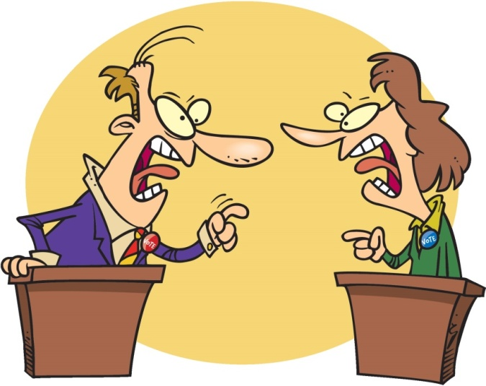
2. argument n.争吵，争论；论点
have an argument with sb. about/over sth. 和某人就某事争吵
【拓展】
a powerful/strong argument 有力的论据；
present an argument 提出论点
an argument in favour of... 支持...的论据；
an argument for/against...支持/反对...的论据
【派生词】
argue vi.争论，争吵
arguble adj.可论证的；可疑的
argumentative adj.好争论的，爱辩论的

Slide 35
Para. 2
Teenagers’ physical changes may result in such family tensions. You may feel anxious that you are developing at a different rate to your friends, shooting up in height or getting left far behind. You might worry about your changing voice, weight problems or spots. When it all gets too much, your parents are often the first targets of your anger.
导致
n.紧张关系
adj.焦虑的
n.速度
长高
被落下
远远落后
担心，忧虑
n.粉刺
when引导的时间状语从句
n.目标

Slide 36
3. tension n.紧张关系；紧张；拉伸
①人与人或国与国之间的紧张关系（可数名词）：
international tensions 国际上的紧张局势;
political tensions 政治上的紧张状况
②情绪上的紧张，绳子、肌肉等的拉伸、绷紧（不可数名词）：
nervous tension 神经紧张;
ease/reduce tension 缓和紧张情绪;
muscle tension 肌肉紧张
He changed the topic in order to ease the tension in the conversation.
他改变了话题,以缓和谈话中的紧张气氛。
【派生词】
tense adj.紧张的；绷紧的 tensely adv. 紧张地；绷紧地

Slide 37
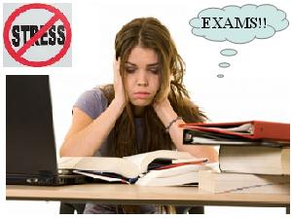
4. anxious adj.忧虑的，担心的；令人焦虑的；渴望的
be anxious about sth. 对某事担心；
be anxious for sb.为某人担心
He was anxious about the safety of his children.
他担心孩子们的安全。
【拓展】表示“令人焦虑的，渴望的”
an anxious moment 一个令人焦虑的时刻；
be anxious to do sth. 渴望做某事；be anxious for sth. 渴望得到某物
She was anxious for her parents' understanding.她渴望得到父母的理解。
【派生词】
anxiously adv.焦急地；anxiety n.焦虑，担心；渴望

Slide 38
5. rate
a measurement of the speed at which sth happens
different
不同的
惊人的
平均的
高的/低的
骇人的，可怕的
alarming
at a(n)
rate
average
high/low
frightening

Slide 39
Guess the meanings of rate in the following sentences.
Australia’s unemployment rate rose to 6.5% in February.
n. 比率，率
2. We offer special reduced rates this week.
n. 价格，费用
3. I may be away next week but at any rate I’ll be back before the meeting.
无论如何，至少
4. At this rate we won’t ever be able to afford a holiday.
这样的话，照这样下去
5. The university is highly rated for its research.
v. 评估，评价
6. He is currently rated number three in the world.
v. 划分等级，分等

Slide 40
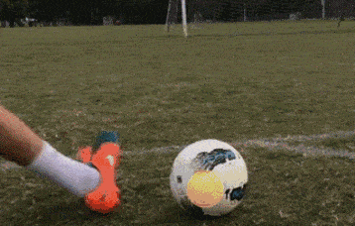


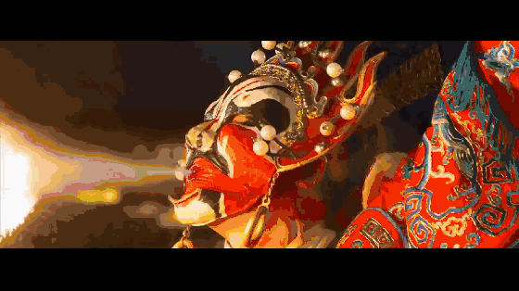
6. shoot

Slide 41
Match the sentences with the meanings of shoot.
Police shot one suspect when he pulled a gun on them.
2. They spent the weekend in the countryside shooting deer.
3. The band’s last single shot straight to number one in the charts.
4. He should have shot instead of passing.
5. The film was shot in New Zealand.
(使朝某方向)冲，奔
射杀，射伤
拍摄，摄影
射门，投篮
打猎，狩猎

Slide 42
7. spot
① n.粉刺；斑点；污渍；地点，场所
The dog with spots on the back behaved quite well in front of the audience.【斑点】
His trousers were covered with spots of mud.【泥点】
a tourist spot【地点】
on the spot【场所】
② vt.发现，注意到
spot sb. doing sth. 发现某人在做某事
spot a mistake 发现一处错误

Slide 43
8. target
① n.(攻击的)目标，对象；靶子；目标
target of/for... ...的对象
hit/miss the target 中/脱靶
a target audience/group/area 目标观众/群体/范围
② vt. 把...作为攻击目标；面向
target sth. on/at... 以...为对象
The advertisement is mainly targeted at teenagers.
这则广告主要针对的是青少年。

Slide 44
Para. 3
It can be a big headache to balance your developing mental needs too. You enter a strange middle ground—no longer a small child but not quite an adult. You have both a new desire for independence and a continued need for your parents’ love and support. You feel ready to be more responsible and make decisions on your own. Unfortunately, your parents do not always agree and that makes you feel unhappy.
n.使人头痛的事
动词不定式作主语
中间地带
n. 愿望，欲望，渴望
adj.（对某人、某事）负责的
adv.不幸地，遗憾地
that做替代词

Slide 45
9. desire
①n [C] & [U] 渴望；欲望：
Reading satisfies my desire to keep learning.
I am inspired by her courage and strong desire to succeed.
She had little desire for power.
Confucius once said, “At seventy I can follow my heart’s desire.”
② vt［不用于进行时］［正式用语］渴望；期望：
He is truly rich who desires nothing.
desire to do sth 渴望做...
He desired to win the game.
他渴望赢得这场比赛。
【派生词】 desirable adj［正式用语］值得做的；值得拥有的；理想的

Slide 46
Para. 3
“Why can’t they just let me go?” you may wonder. On the other hand, when you are struggling to control your feelings, you wish they could be more caring and patient—sometimes they forget that growing up is a rough ride. It can be difficult when your parents treat you like a child but expect you to act like an adult. All of this can lead to a breakdown in your relationship.
v.想知道
v.努力
adj.体贴的
adj.有耐心的
adj.艰难的
v.对待
n.（关系的）破裂

Slide 47

10. struggle
■ n [C] 斗争；奋斗；难事：
The struggle for freedom was long and hard.
Never give up without a struggle.
It was a struggle for her to make him understand.
为...的斗争
未经奋斗
对于她来说是难事

Slide 48
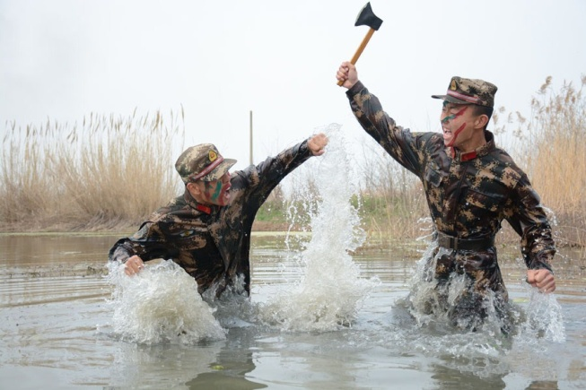

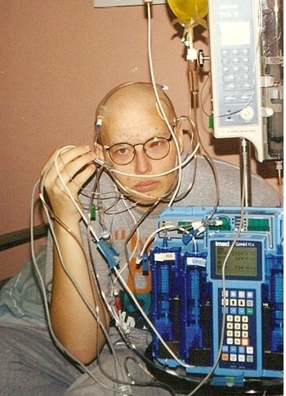
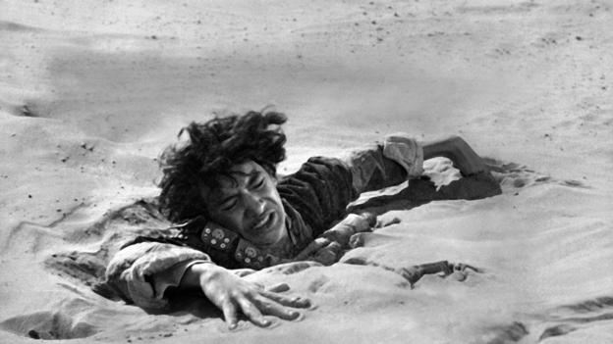
10. struggle
（与人）搏斗
奋力前进
挣扎
斗争

Slide 49
■ vi（与某人）搏斗；斗争；奋力前进；挣扎：
struggle through the snowstorm 在暴风雪中挣扎
struggle to one’s feet 挣扎着站起来
① struggle with / against:
He has been struggling with illness for years.
他多年来一直在与疾病作斗争。
② struggle for / to do sth:
struggle for freedom / independence / human rights
为自由/独立/人权而斗争
Many of the families were struggling to make ends meet.
许多家庭都在努力维持收支平衡。

Slide 50
11. breakdown n.（汽车或机器的）故障，损坏；（关系的）破裂，（系统的）瘫痪；精神崩溃，（健康、体力等的）衰竭
a failure of a relationship, discussion or system
E.g. This led to the breakdown of the negotiations.
breakdown
breakthrough
outbreak
overturn
break down
break through
break out
turn over

Slide 51
11. break down
The printing machines are always breaking down.
2. Negotiations between the two sides have broken down.
3. She broke down in tears when she heard the news.
4. He showed us the whole dance, and then broke it down
so that we could learn it more easily.
5. Her health broke down under the pressure of work.
to stop working because of a fault 出故障
to fail 失败
to lose control of your feelings and start crying 情不自禁地哭起来
to divide sth into parts to analyse it or make it easier to do划成部分
to become very bad 垮掉

Slide 52
Para. 4
Although sometimes it may seem impossible to get along as a family, you can take action to improve the situation. The key to keeping the peace is regular and honest communication. When you disagree with your parents, take a minute to calm down and try to understand the situation from their point of view.
采取行动
做...的关键
adj.规律的
adj.坦诚的
不同意
v.使平静
n.观点

Slide 53
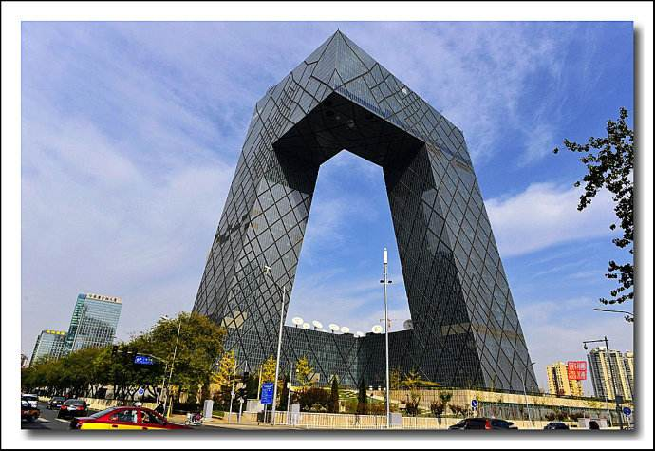

12. regular
① 规则的；有规律的；定期的 反 irregular
The sides of the building aren’t regular, so the building has an unusual shape.
这座建筑的两边不是规则的，所以它的形状很不寻常。The equipment is checked on a regular basis.
设备是定期检查的。
② [只用于名词前] 经常的；频繁的
happening or doing sth very often; frequent：
regular customers 老顾客

Slide 54
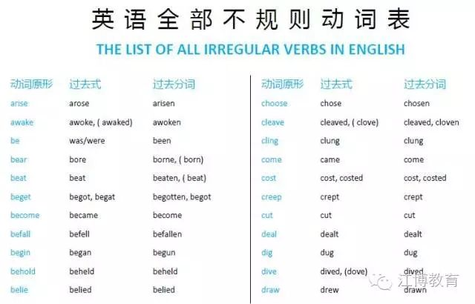
12. regular
【词汇拓展】
regularly adv.
有规律地；定期地；
经常
③[只用于名词前]正常的；惯常的；普通的：
a regular school / class 常规学校/班级
Our regular opening hours are 10 a.m. to 7 p.m.
我们的正常营业时间是上午10点到晚上7点。
④持久的；稳定的
lasting or happening over a long period：
Maybe a regular job won’t be as dull as I feared.
也许一份稳定的工作并不像我担心的那么无聊。
⑤ [语法]规则的
regular verbs and irregular verbs
规则动词和不规则动词

Slide 55
13. calm
adj.①(天气、海洋等) 静的；平静的：
The weather was fine and the lake was calm.
天气很好，湖面很平静。
adj.② (人) 镇静的；沉着的：
If you are lost in the mountains, stay / keep calm in the face of darkness, loneliness, and the unknown.
如果你在山里迷路了，面对黑暗、孤独和未知，要保持冷静。

Slide 56

13. calm
vt & vi (使) 平静；平静下来：
The deep, gentle voice helped calm the nervous girl.
那低沉、温柔的声音帮助那个紧张的女孩平静下来。
calm down (使) 平静下来； (使) 镇静下来：
I placed the chick in the nest, and it quickly calmed down.
我把小鸡放在窝里，它很快就安静下来了。
n [C] & [U] 平静；镇静：
After a storm comes a calm. （翻译）
雨过天晴

Slide 57
14. view
While climbing the mountain, we enjoyed the warm sunshine and a beautiful view.
The plane soon went out of view.
The lake came into view as we turned the corner.
In my view, education is the key to success.
景色
视线
视线
看法；观点

Slide 58
Choose the phrases from the box to complete the sentences.
support the view come into view view … as …
in view of in one’s view
In view of
____ ____ ____ the weather, the event will now be held indoors.
2. When the car was first built, the design ____ ______ ____ highly original.
3. This evidence ________ ___ _____ that there is too much violence on television.
4. The lake soon ____ ____ ____.
5. ____ ____ ____ it was a waste of time.
was
viewed as
supports the view
came into view
In my view

Slide 59
Para. 4
Perhaps they have experienced something similar and do not want you to go through the same pain. After you have thought it through, explain your actions and feelings calmly, listen carefully, and address their concerns. Through this kind of healthy discussion, you will learn when to back down and when to ask your parents to relax their control.
类似的东西
经历
prep.完全;彻底
v.处理
n.担心，忧虑
退缩，让步

Slide 60
15. go through 经历，遭受
to experience or suffer sth
E.g. He was going through a very difficult time.
他正在经历一段非常困难的时期。

Slide 61
15. go through
We went through five pints of milk last week.
She went through her bag looking for the keys.
3. Let’s go through the arguments again.
4. The deal failed to go through.
to use up or finish sth completely 用完，耗尽
to look at or examine sth carefully, especially to find sth 检查某事物
to study or consider sth in detail, especially by repeating it 详细研究
to be officially accepted or completed 通过，接受

Slide 62
15. go through
They were suddenly plunged into （使陷入）darkness as the train
went through a tunnel.
through
across
over

Slide 63
16. concern n.担心；忧虑；关心
a feeling of worry, especially one that is shared by many people
express
voice
show
raise
address
concern
about
for
over
that
表达
引发
解决
growing
widespread
primary
日益增长的
广泛的
主要的

Slide 64
16. concern
concern n.
concern v.
concerned adj.
concerning prep.
She was concerned that she might miss the turning and get lost.
worried and feeling concern about sth 担心的
What concerns me is our lack of preparation for the dry season.
to worry sb 让某人担忧
As far as Americans are concerned, a lot of our hotels are below average.
used to show what someone’s opinion on a subject 就...而言
He asked several questions concerning the causes of the accident.
about sth; involving sb/sth 关于, 涉及

Slide 65
Fill in the blanks with the proper forms of concern.
1. He expressed _______ over the spread of the disease.
2. Many people are _________ about the current economic situations.
3. Discussions ___________ the plan got under way on 15th March.
4. Our primary _________ is providing jobs for young school leavers.
5. As far as I’m ___________, the children come first.
6. It _________ me that you no longer seem to care.
concern
concerned
concerning
concern
concerned
concerns

Slide 66
语境串记
用concern的适当形式填空
The mayor was very ________ about the workers’ safety. He showed much _________ for those who worked underground and asked them some questions____________safety.He asked the officials _____________to put safety at the first place.
市长很关心工人的安全。他对那些在地面下工作的人非常关心，并且问了他们一些关于安全的问题。他要求相关的官员把安全放在第一位。
concerned
concern
concerning
concerned

Slide 67
Para. 5
Just remember that it is completely normal to struggle with the stress that parent-child tensions create, and that you and your parents can work together to improve your relationship. The good news is that this stormy period will not last. Everything will turn out all right in the end, and the changes and challenges of your teenage years will prepare you for adulthood.
与……斗争
压力
that引导的表语从句
结果很好
为……做好准备
n. 成年，成人时期

Slide 68
17. stress
pressure or worry caused by problems
deal with
cope with
struggle with
suffer from
relieve
reduce
stress
e.g. Things can easily go wrong when people are under stress.

Slide 69
17. stress
n. 精神压力，紧张；强调，重要性
vt. 强调，着重
The company places too much stress on cost and not enough on quality.
She lays great stress on punctuality.
n. special importance given to sth 重要性
I must stress that everyone must keep the project a secret.
He stressed the importance of a good education.
v. to emphasize a fact, an idea, etc. 强调
In “strategic”, the stress falls on the second syllable.
n. an extra force used when pronouncing a particular word/syllable 重音
You stress the first syllable in “happiness”.
v. to give extra force to a word or syllable when saying it 重读

Slide 70
Translate the following sentences.
一些人受工作压力的影响，最后病倒了。
Some people _________________ at work and become ill as a result.
2. She _______ the syllables as though teaching a child .
她重读这些音节，像教小孩似的。
3. 我总是一紧张就吃东西。
I always eat when I'm _____________.
suffer from stress
stresses
under stress

Slide 71
At the 2024 China Ice and Snow Tourism Development Forum held on Friday in Harbin, Heilongjiang province, Harbin Ice and Snow World (recognize) by Guinness World Records as the world's largest ice and snow park, with an area of 816,682.5 square meters. The park,_ combines ice, snow, sound and lights, (official) opened for its 25th year. (tour)can be amazed at more than 1,000 works of art made of more than 250,000 cubic meters of ice and snow or participate in numerous activities, including a 521-meter ice slide, the longest one (build) at the park to date. A giant Ferris wheel in the shape of a snowflake has been built to provide unique experience in the dazzling(耀眼的) world after dark.
was recognized
which
officially
Tourists
built
a

Slide 72
The 40th Harbin International Ice and Snow Festival-the city's annual winter gala-kicked off at the park, (welcome) people from around the world, “Heilongjiang not only has plentiful ice and snow resources, it is also the birthplace of China's modern ice and snow industry,” Heilongjiang Governor LiangHuiling said at the opening ceremony. “ Currently, Heilongjiang is vividly developing cultural tourism and carrying out activities
(promote) the ice and snow economy.” The park's popularity has helped the (develop) of the whole province's snow and ice economy, she added.
welcoming
but
to promote
development

